Slide 1
Diversity of beliefs/ dogmas
Dogmas are like knowledge whereas remaining things are practice.
Practice always follows knowledge.
Some are base
Some like walls
Some represent as roof
Others are like attire (garments)

Slide 2
Defination of Tauheed
Tauheed is derived from the Arabic word W-h-d, which means oneness, unity or singularity and uniqueness.
In the light of Shariah: To submit or confess the lordship(entity) of Allah and to purify Allah’s names and attributes and not to associate any thing with Him

Slide 3
What does it mean by believing in Allah
Firm belief that His entity exists
The belief that this universe has not come to existence accidently
Nor is it running automatically with out any cause
But it has a creator, sustainer, organizer and an administrator, who is always taking care of it.

Slide 4
KINDS OF TAUHEED
Believing that Allah is one and unique in His being(lordship)
Believing that Allah is one and unique in His attributes( sifat)
Believing that Allah is one and unique in the implication of His attributes/ in His right to be worshiped

Slide 5
THE ENTITY OF ALLAH
Allah is the entity that has created the whole universe.
اَللّٰهُ خَالِقُ كُلِّ شَيْءٍ
Allah is different from all other beings and none is similar to Him
لَيْسَ كَمِثْلِهٖ شَيْءٌ
He is beyond the imagination and can’t be compared.
وَلِلّٰهِ الْمَثَلُ الْاَعْلٰى
He begets not, nor was He begotten.
لَمْ يَلِدْ وَلَمْ يُوْلَدْ

Slide 6
Attributes of Allah
Al Awal: He is eternal, the everlasting and the self existing. He exists of His own.
Al Khaliq: He is the only creator.
Al Wahid: He posses the glory of being one
Al Aleem: He is the one who knows everything
Al Naseer: He is the one from whom we seek help

Slide 7
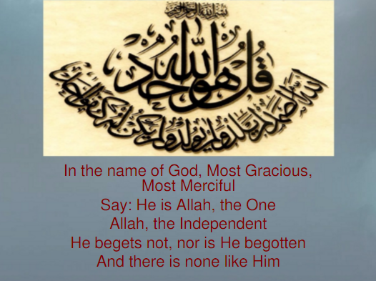

Slide 8
Atheist scientists two theories
Whatever is approached by material means, they believe it without any hesitation, but refuse to accept any thing that is beyond it.
It is too an unscientific approach, because absence of knowledge about any thing does not prove its non-existence.
The material discoveries and mysteries of universe that have come to light in the recent past and were not known to early generations, yet they existed in those days, despite the fact they were not known by previous generations.

Slide 9
2nd theory
It says that when scientists’ don’t know any thing and are quite in dark about it. They are not in a position to admit it with certainty or discard it.
This approach is also absurd and illogical.
It is absolutely unscientific to probe into an immaterial problem by material method.
Therefore, we have only one method that is Prophethood. They are certain and free from tinge of doubt.

Slide 10
ARGUMENTS ABOUT THE EXISTENCE OF ALLAH
The discipline and control of the universe.
Argument from agriculture
Argument from milching animals.
Argument from air and water
Argument from cause and effect
Different creative stages of a man

Slide 11
Scientists views about Allah
Dr lee kamtay if we have a critical analysis of all the wealth of science and deduce logical result . It leads us to only one God.
Professor Jode says” hundreds and thousands evidences are spread in this universe. These all indicate towards perfect authoritative entity.
Dr Arthour Kete says:” human mind is a tiniest equipment to asses the biggest questions of this universe. We should, therefore, confess the compulsions of this mind.

Slide 12
Sir Fred Hoyle 1915 –2001
Probability of life originating on earth is no greater than the chance that a hurricane sweeping through a scrapyard would have the luck assembling the Boeing 747
there are no blind forces worth speaking about in nature.."

Slide 13
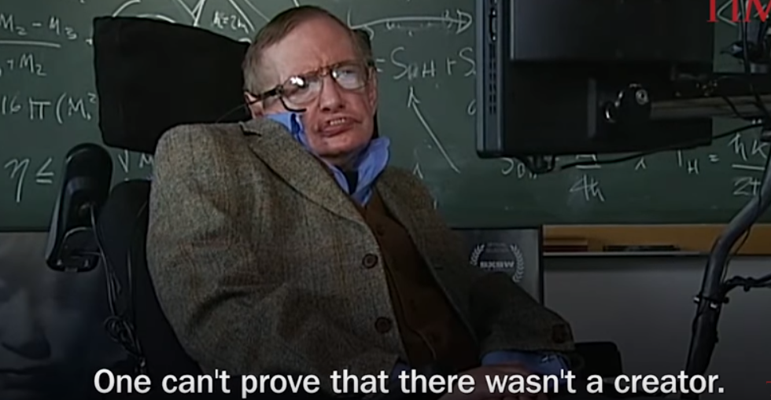
Stephen Hawking (physicist

Slide 14
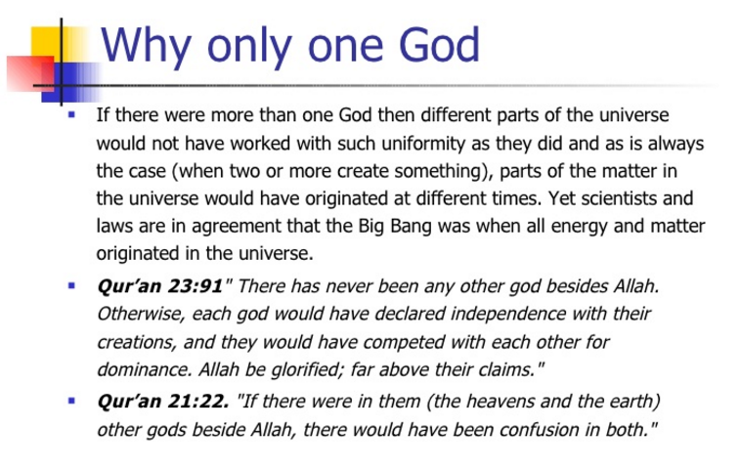

Slide 15
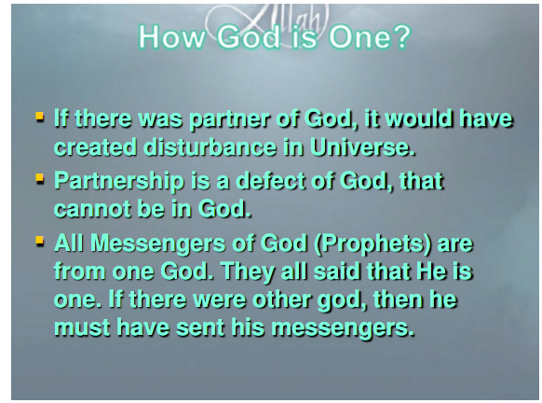

Slide 16
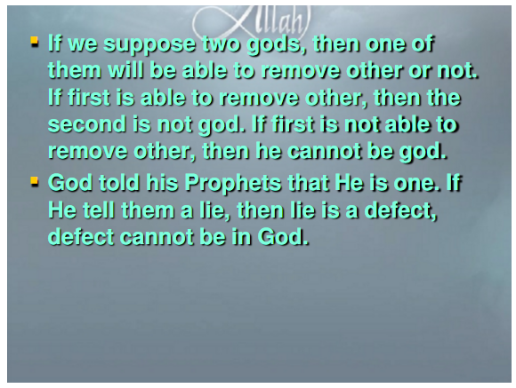

Slide 17
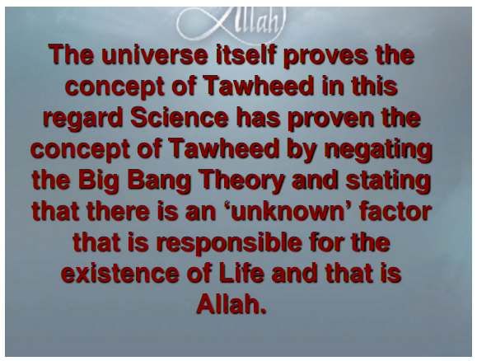

Slide 18
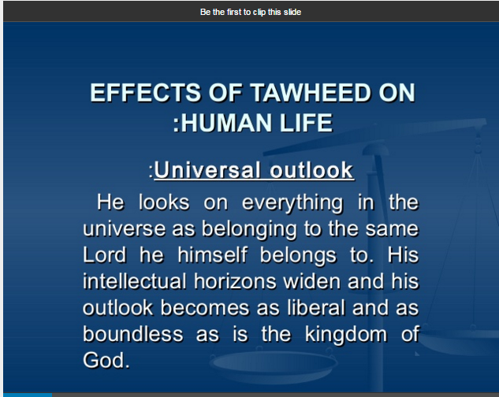

Slide 19
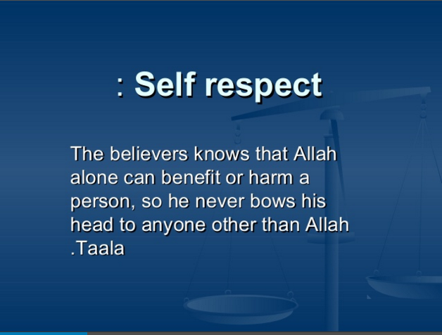

Slide 20
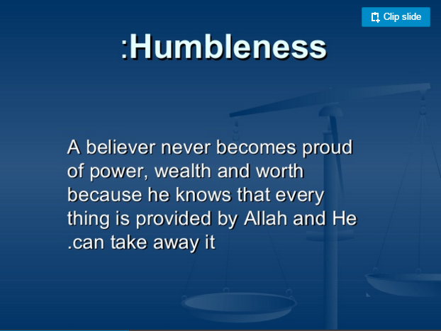

Slide 21
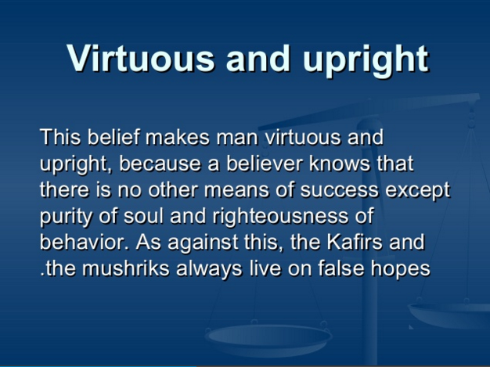

Slide 22
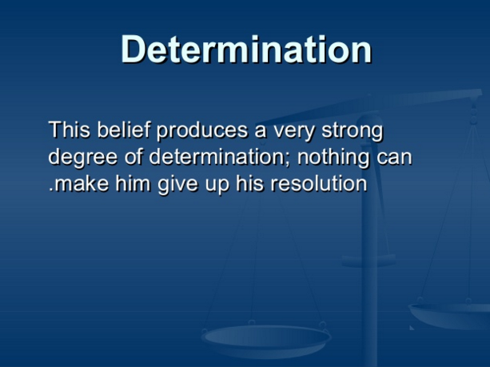

Slide 23
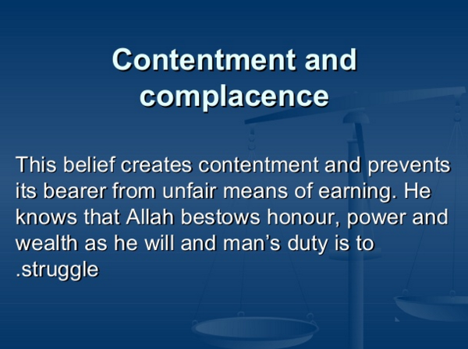

Slide 24


Slide 25
